Slide 1


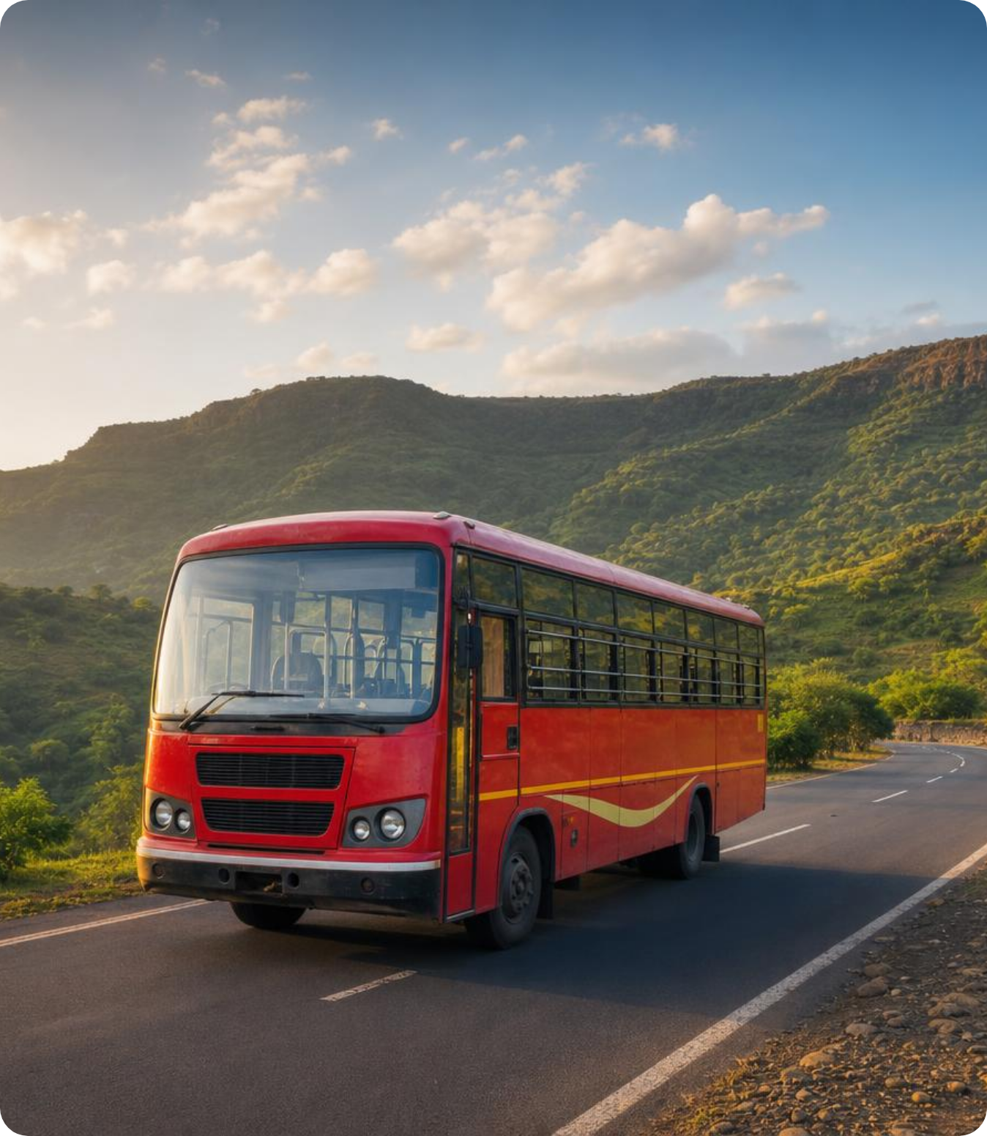
PROJECT PRESENTATION
2026
SMART TRANSIT INITIATIVE
Maharashtra
Transit Service
Smart Bus Tracking & Passenger Management System
for Maharashtra
DAILY BUS TRIPS
ANNUAL PASSENGERS
2.5 L+
7.5 Cr
MSRTC
Yearly
Maharashtra State Road Transport Corporation
Maharashtra Transit Service
•
Slide 1

Slide 2

PROBLEM STATEMENT
2026
CURRENT CHALLENGES
1
No Real-Time Bus Visibility
Problem
Commuters have no live tracking of bus locations or estimated arrival times
Statement
2
No Crew Assignment Tracking
No centralized system to track driver and conductor assignments on each bus
Maharashtra's public bus network faces critical gaps
in real-time visibility, crew accountability, and digital
access for passengers.
Manual Ticketing Revenue Leakage
3
Manual ticketing and pass issuance leads to long queues and significant revenue leakage
4
Zero Rural Route Monitoring
Remote routes in rural Maharashtra have no monitoring or safety checks in place
86%
of passengers report unreliable bus information
5
Unreliable Journey Planning
Passengers cannot plan journeys reliably, reducing trust in public transport
Maharashtra State Road Transport Corporation
Maharashtra Transit Service
•
Slide 2

Slide 3

NEED OF PROJECT
2026
WHY THIS MATTERS
Need of
the Project
Growing Urban Population
Maharashtra's rising urban population demands smart, data-driven transit solutions
Digital India Alignment
MSRTC DAILY OPERATIONS
Digital India & Smart Cities Mission mandate modernization of public transport
2.5L+
bus trips per day across Maharashtra
Crew Safety & Accountability
Safety and accountability of drivers and conductors requires real-time tracking
ANNUAL RIDERSHIP
Operational Cost Reduction
7.5 Cr
Online ticketing reduces operational costs and improves the passenger experience
passengers served annually
Fleet Management Efficiency
Real-time GPS data enables better route planning and resource allocation for MSRTC
DIGITAL INDIA MANDATE
Smart Cities Mission requires modernization of public
transport infrastructure
Maharashtra State Road Transport Corporation
Maharashtra Transit Service
•
Slide 3

Slide 4
OBJECTIVES
2026
PROJECT GOALS
Objectives
1
Real-Time GPS Bus Tracking
2
Live Location for Passengers
Enable live GPS tracking of government buses across all Maharashtra routes
Provide passengers real-time bus location and ETA via mobile app and web
3
Digital Crew Assignment Database
4
Online Pass & Ticket Booking
Maintain a digital record of driver and conductor assignments per bus at all times
Allow online booking of passes and tickets, reducing counter queues
significantly
5
Improve Fleet Management & Operational Efficiency
Reduce operational inefficiencies for MSRTC through data-driven fleet management and route optimization
Maharashtra State Road Transport Corporation
Maharashtra Transit Service
•
Slide 4

Slide 5






TEAM MEMBERS
2026
OUR PROJECT TEAM
Team Members
A
K
O
Y
V
Aayaan D. Kalawant
Kunal S. Sapate
Omkar N. Chougule
Yash V. Tare
Vivek M. Chougale
Team Member
Team Member
Team Member
Team Member
Team Member
Maharashtra Transit Service — Project Team 2026
Maharashtra State Road Transport Corporation
Maharashtra Transit Service
•
Slide 5

Slide 6

METHODOLOGY
2026
1
Requirements Gathering
MSRTC stakeholder interviews, route mapping, and requirement finalization
DEVELOPMENT PLAN
Methodology
2
System Architecture Design
Design GPS module, backend API, and passenger-facing app architecture
& Plan
3
Bus Tracking Module Development
Develop GPS hardware integration and phone-based tracking fallback system
A structured 6-phase approach from requirements
gathering to full public deployment across MSRTC routes.
4
Crew Management Portal
Build driver and conductor assignment management portal for MSRTC admin
6
5
Online Ticket & Pass Booking
Development Phases
Integrate online pass and ticket booking with Razorpay/UPI payment gateway
6
Testing, Deployment & Public Rollout
Comprehensive testing, deployment, and phased public rollout across MSRTC routes
Maharashtra State Road Transport Corporation
Maharashtra Transit Service
•
Slide 6

Slide 7

TECHNOLOGY
2026
TECH STACK
Technology Preferences
TRACKING
BACKEND
DATABASE
MAPS
GPS Hardware
Node.js / Python
PostgreSQL + Redis
OpenStreetMap
GPS devices + fallback phone-based GPS
via 4G/5G networks
REST API with real-time WebSocket
updates for live tracking
Structured data in PostgreSQL; Redis for
live location caching
OpenStreetMap / Google Maps API for route
visualization
MOBILE
PAYMENTS
HOSTING
React Native
Razorpay / UPI
NIC / Govt Cloud
Android-first app for Maharashtra passengers with live bus
tracking
Razorpay and UPI integration for pass and ticket booking
payments
Maharashtra government cloud via National Informatics Centre
(NIC)
Maharashtra State Road Transport Corporation
Maharashtra Transit Service
•
Slide 7

Slide 8
EXPECTED OUTCOMES
2026
IMPACT PROJECTIONS
Expected Outcomes
WAIT TIME REDUCTION
CREW TRACKING
TICKETING WORKLOAD
30%
100%
50%
reduction in passenger wait time through accurate ETA
predictions
digital tracking of driver and conductor deployment per
bus
reduction in manual ticketing workload at MSRTC counters
Live Bus Tracking
Increased Public Trust
Foundation for Smart Transit
Real-time bus location visible to all passengers within 6
months of launch
Higher ridership on MSRTC services through improved
reliability and transparency
Enables future features: crowd monitoring, route
optimization, demand forecasting
Maharashtra State Road Transport Corporation
Maharashtra Transit Service
•
Slide 8

Slide 9
PROJECT TIMELINE
2026
12-MONTH ROADMAP
Project Timeline
1
2
3
4
5
6
7
8
9
10
11
12
Research & Planning
Month 1–2
System Design
Month 3–4
Core Development
Month 5–7
Booking Integration
Month 8–9
Testing & QA
Month 10
Pilot & Rollout
Month 11–12
Core Track (Red)
Design & QA Track (Navy)
Integration Track (Orange)
Maharashtra State Road Transport Corporation
Maharashtra Transit Service
•
Slide 9

Slide 10
REFERENCES
2026
SOURCES & RESEARCH
References
01
MSRTC — Official Website
02
Smart Cities Mission Reports
msrtc.maharashtra.gov.in
smartcities.gov.in
03
National Informatics Centre (NIC)
04
GPS Fleet Management — IEEE
nic.in
IEEE Transportation Research Publications
05
Digital India Transport Initiatives
06
OpenStreetMap Maharashtra Data
digitalindia.gov.in
openstreetmap.org
Maharashtra State Road Transport Corporation
Maharashtra Transit Service
•
Slide 10

Slide 11



CONCLUSION
2026
SUMMARY
Conclusion
Bridging Citizens & Public Transport
Smart, Connected Bus Network
Maharashtra Transit Service closes the information gap between passengers and
the bus network
A connected bus network improves safety, reliability, and operational efficiency
across Maharashtra
Digital Ticketing & Crew Tracking
Digital Infrastructure Vision 2030
Online ticketing and crew tracking bring accountability, transparency, and
convenience
This project aligns with Maharashtra's Digital Infrastructure Vision 2030 and
Smart Cities roadmap
Together, we can make public transit smarter, safer, and more accessible for every
Maharashtrian.
Maharashtra State Road Transport Corporation
Maharashtra Transit Service
•
Slide 11

